Slide 1
MIS3690 Web Technologies
Babson College
TOIM Division
Fall 2015

Slide 2
Image Hot-Spots/MAPS HTML Lists & more CSS Positioning Images

Slide 3
Image Hot-Spots or Image Maps
Link areas within large images to another page or web site.
Create Image Maps
Divide the image into two (or more) smaller areas
Link one or more of these areas to web sites/pages – i.e., make the area "clickable"
The "clickable" area is referred to as a Hot Spot

Slide 4
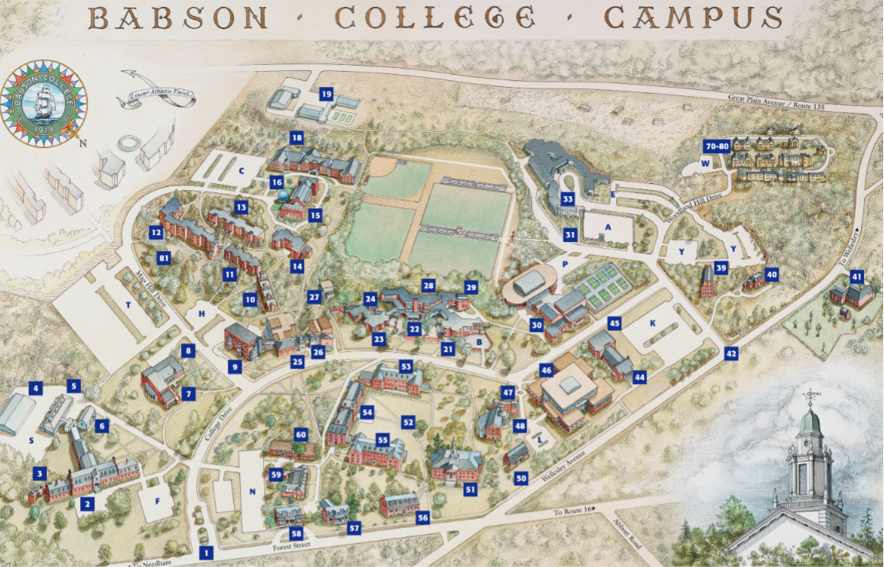
Clickable Areas – Hot Spots

Slide 5
Defining Image Maps
The following shapes can be defined:
shape="default | rect | circle | poly"
Rectangle – specify the coordinates for the top left corner and the bottom right corner
Circle – specify the coordinates for the center and the length of the radius
Any polygon – specify the coordinates for each of the corners.
E.g. Triangle – specify the coordinates for the 3 apex points (the corners)
We will use Microsoft Paint to identify the coordinates
Notes:
You can use paint to identify coordinates

Slide 6
Clickable Areas – Hot Spots
461, 290
360, 249
<area shape="rect" coords="360, 250, 461, 290" href="http://www.babson.edu/Academics/library/Pages/home.aspx" alt="Horn Library" title="Horn Library" target="_blank" />

Slide 7
Putting the Image Map Together
<p><a href="../index.htm">back to index</a></p>
<map name="babson"/>
<area shape="rect" coords="360, 250, 461, 290" href="http://www.babson.edu/Academics/library/Pages/home.aspx" alt="Horn Library" title="Horn Library"target="_blank" />
<area shape="rect" coords="119,317, 185,375" href="https://babsondining.sodexomyway.com/" alt="Trim Dining Hall" title="Trim Dining Hall" target="_blank"/>
<area shape="rect" coords="452,229 512,282" href="http://babsonathletics.com/information/facilities/webstercenter" alt="Webster Center" title="Webster Center" target="_blank"/>
<img src="../images/babsonmap.png" usemap="#babson" alt="Map of Babson" title="Clickable Map"/>
Names must match
Notes:
Link back to index
Get rid of 2 dots

Slide 8
CS04-InClass.htm
Download "template.htm" from Blackboard--Class Session 04
We want to create two hot-spots on the image "Middlesex.gif" (available in Blackboard--Class Session 04)
Link Wellesley 301, 351, 330, 383 to http://www.wellesleyma.gov/ – the Town of Wellesley’s website.
Link Newton 338, 314, 360, 373 to http://www.newtonma.gov/ - the City of Newton’s website.
Save the file as CS04-InClass.htm
Check it using Firefox
Keep CS04-InClass.htm open – we will extend it with more "stuff"!
Notes:
Circle has three numbers
Makes map more interactive

Slide 9
Lists on Web Pages
There are 3 types of lists:
Unordered lists
Bulleted list of items
Ordered Lists
Numbered list of items
Definition Lists
List of terms and their definitions

Slide 10
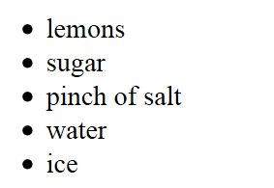
Un-Ordered Lists (you elle) (ul)
Defined by the <ul> and </ul> tags
Each item on the list is marked using <li> and </li> tags
Combination of both defines the list.
E.g., ingredients for lemonade:
<ul>
<li> lemons </li>
<li> sugar </li>
<li> pinch of salt </li>
<li> water </li>
<li> ice </li>
</ul>
Notes:
Can change the shape of bullets (will show later)

Slide 11
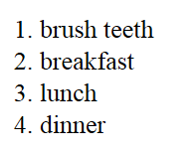
Ordered Lists (oh elle) (ol)
Defined by the <ol> and </ol> tags
Each item on the list is marked using <li> and </li> tags
Combination of both defines the list.
E.g., top 4 things to do today in specific order:
<ol>
<li> brush teeth </li>
<li> breakfast</li>
<li> lunch</li>
<li> dinner </li>
</ol>

Slide 12
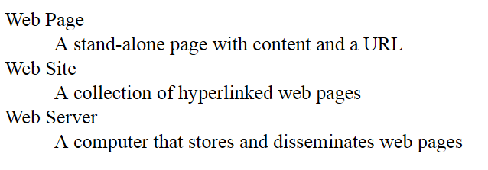
Definition Lists
Defined by the <dl> and </dl> tags
Each term is PREFIXED by the <dt> tag
Each definition is PREFIXED by <dd> tag
E.g., web terminology
<dl>
<dt> Web Page
<dd> A stand-alone page with content and a URL
<dt> Web Site
<dd> A collection of hyperlinked web pages
<dt> Web Server
<dd> A computer that stores and disseminates web pages
</dl>

Slide 13
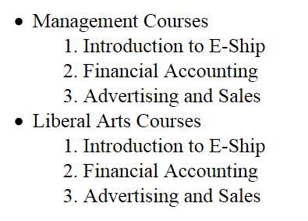
Nesting Lists
<ul>
<li> Management Courses
<ol>
<li> Introduction to E-Ship </li>
<li> Financial Accounting </li>
<li> Advertising and Sales </li>
</ol>
</li>
<li> Liberal Arts Courses
<ol>
<li> Introduction to E-Ship </li>
<li> Financial Accounting </li>
<li> Advertising and Sales </li>
</ol>
</li>
</ul>
Notes:
Lists within lists

Slide 14
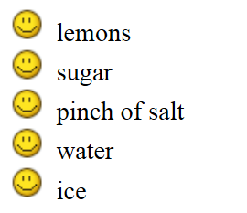
Using CSS with Lists
You can format the text in a list using CSS
Font, color, text, background, alignment etc.
One specific formatting – using an image for the bullet in un-ordered lists
ul {list-style-type: disc | circle | square;}
You can set the bullet to any one of disc/circle/square
ul {list-style-image: url (image-file-name);}
e.g. , if the bullet image you want is "smiley.gif"
ul {list-style-image: url(images/smiley.gif)};

Slide 15

CS04-InClass.htm (cont.)
Add an unordered list of the courses you are taking this semester.
Add "My Courses" as h2.
Use "smiley.gif" as the bullet image.
Add an ordered list of the countries that ranked top 4 in 2014 FIFA World Cup.
Add "2014 FIFA World Cup Ranking" as h2.
Add national flag before each country name.
Resize the flags – e.g. height="30"
Add horizontal rules before the unordered list and after the ordered list.
Check it using Firefox
Keep CS04-InClass.htm open – we will add more "stuff"!

Slide 16
Using Images as Background
Using CSS, we can set back-ground images for web pages or even part of web pages using the following properties:
background-image: url ('imagefile.jpg')
background-attachment: fixed | scroll
background-repeat: repeat | norepeat | repeat-x | repeat-y
background-position: center |top | bottom | left | right|(x,y)
You can set these independently or ALL at once:
[background-color] | [background-image] | [background-repeat] | [background-attachment] | [background-position]
Example:
body {background: url (file.jpg) center fixed repeat};

Slide 17
Positioning Images…
img {
float: left | right
Allows the image to move to one side and the rest of the content flows around it on the other side
clear: both | left | right |none
Allows the side of the image to be clear of any other FLOATING content – i.e., prevents content (that are positioned using FLOAT) from flowing around on that side
}

Slide 18
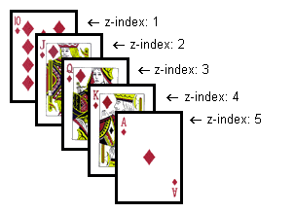
More positioning…
Float does not let you specify where exactly you want the image to be
The combination of the following two will allow you to do this
position: relative | absolute | static
left: auto | distance-value (pt or px)
top: auto | distance-value (pt or px)
z-index: value
allows you to decide whether the element must be above or below other elements that overlap its position.
Notes:
Z index allows overlapping depending on positive or negative
Can set image position to relative to go after and in between the content

Slide 19
CS04-InClass.htm (cont.)
Add "music.gif" as the background image for the page.
Add the image "beaver.jpg" and position it so that it is at the bottom of the page and horizontally centered.
Add the words "Go Beavers!" (as h3) and place it OVER the beaver image
Using different z-index for img and h3
Using h3 {position: relative; top: ?; z-index: ?}
Save the file and submit it as CS04-InClass.htm

